Slide 1
BENDING THE CURVE OF BIODIVERSITY DECLINE
GROUP 23
1

Slide 2
OUTLINE
Introduction (Trends in biodiversity decline)
Effects of Biodiversity decline
Bending the curve of Biodiversity decline
The need to bend the curve
How to bend the curve of biodiversity decline
Challenges associated with bending the curve
Conclusion
References
2

Slide 3
INTRODUCTION
Biodiversity is being lost at a rate unprecedented in human history.
There’s an average decline of 69% in species population since 1970 -World Wide Fund for Nature (WWF).
Biodiversity is declining rapidly and the pressures driving this decline are also intensifying.
3

Slide 4
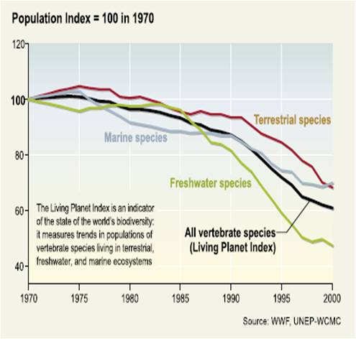
INTRODUCTION CONT’D
Biodiversity is declining due to habitat destruction, Invasive species, Pollution, Overexploitation of resources and Climate change.
4

Slide 5
EFFECT OF BIODIVERSITY DECLINE.
Loss of biodiversity has a cascading effect on ecosystem and the environment leading to;
A decline in ecosystem services, ecosystem stability and genetic resources.
Disruption of nutrient cycling
Increased risk of species extinction.
5

Slide 6
BENDING THE CURVE OF BIODIVERSITY DECLINE
The concept of ‘Bending the curve’ refers to the goal of reversing the decline in biodiversity and shifting from a trajectory of continuous loss to a trajectory of recovery and conservation.
The pathway for bending the curve involves ways to halt biodiversity loss, conserve biodiversity and reverse it.
6

Slide 7
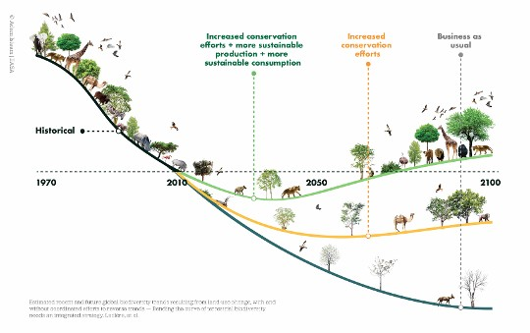
BENDING THE CURVE OF BIODIVERSITY DECLINE CONT’D
7

Slide 8
BENDING THE CURVE OF BIODIVERSITY DECLINE CONT’D
The aim of Bending the curve is to significantly reduce biodiversity loss and start moving towards an upward trend.
This can be done by tackling the drivers of biodiversity loss through diet shift, reduced waste and sustainable increase in trade and crop yield.
8
8

Slide 9
THE NEED TO BEND THE CURVE
Nature has a critical role to play in mitigating climate change, maintaining the quality of soil, air and water and so failure to address these challenge will lead to the continuous loss and destruction of biodiversity.
Bending the Curve provides a roadmap to restore biodiversity and feed a growing human population.
9
8

Slide 10

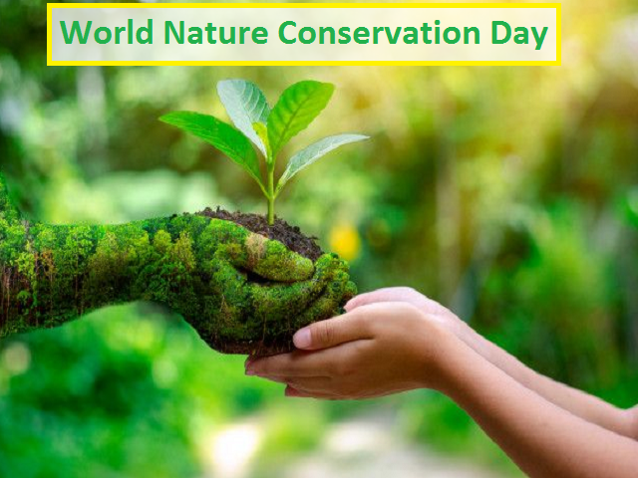
HOW TO BEND THE CURVE
To bend the curve and conserve biodiversity, these critical actions must be taken.
Increase habitat protection and conservation
10

Slide 11
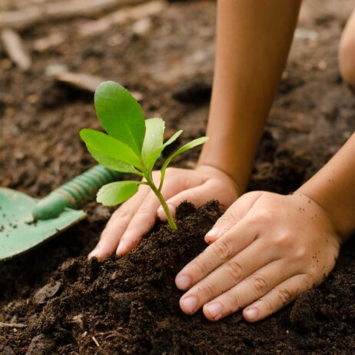
HOW TO BEND THE CURVE CONT’D
Sustainable Land use and Reforestation
11

Slide 12

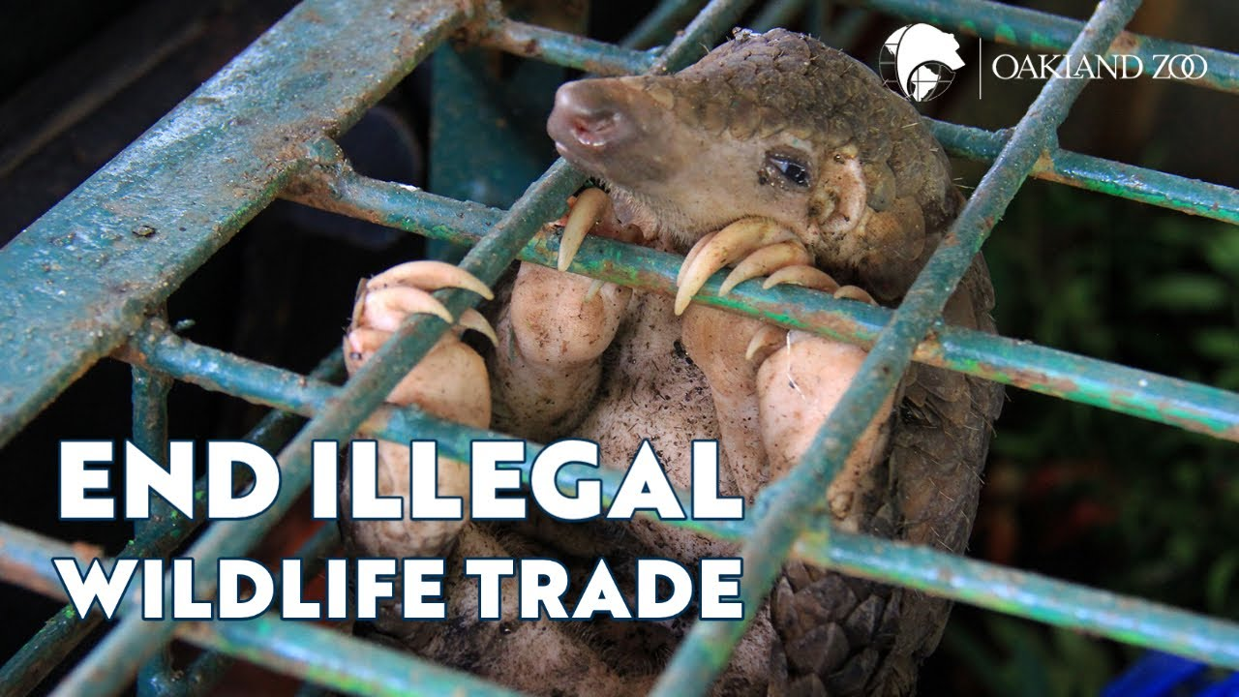
HOW TO BEND THE CURVE CONT’D
Sustainable production of agriculture, trade and goods and combating illegal wildlife trade
12

Slide 13
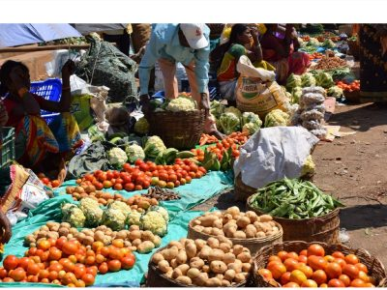

HOW TO BEND THE CURVE CONT’D
Sustainable consumption including reducing food waste
13

Slide 14
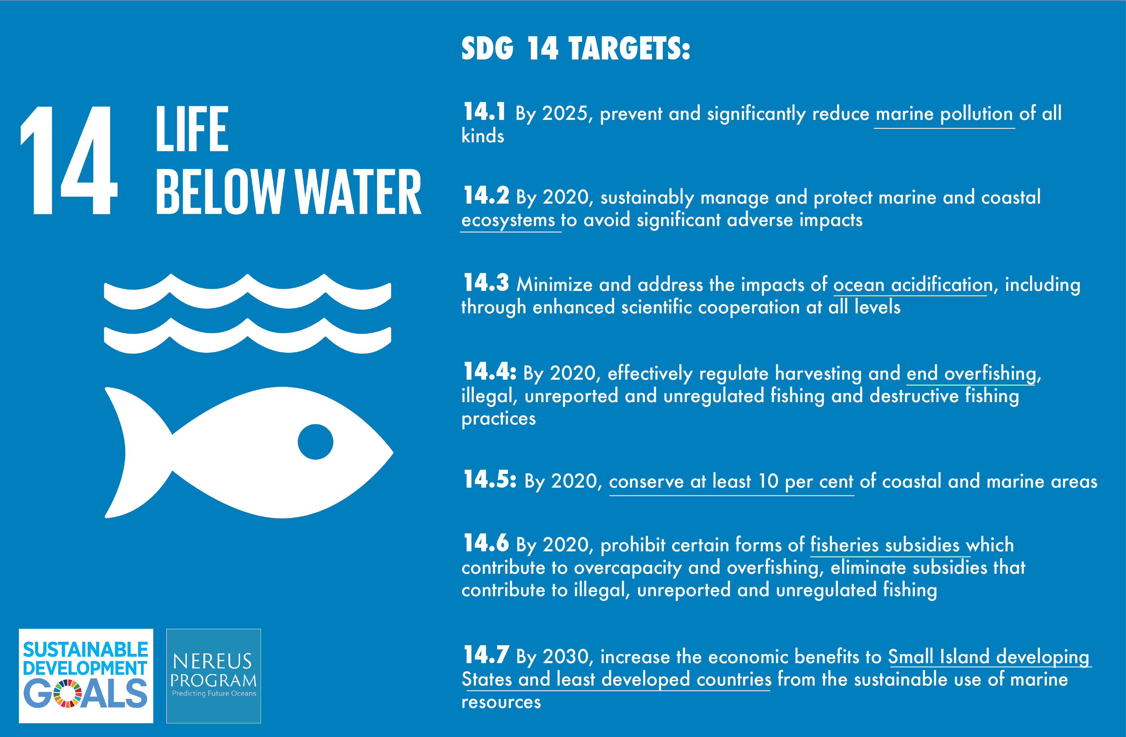
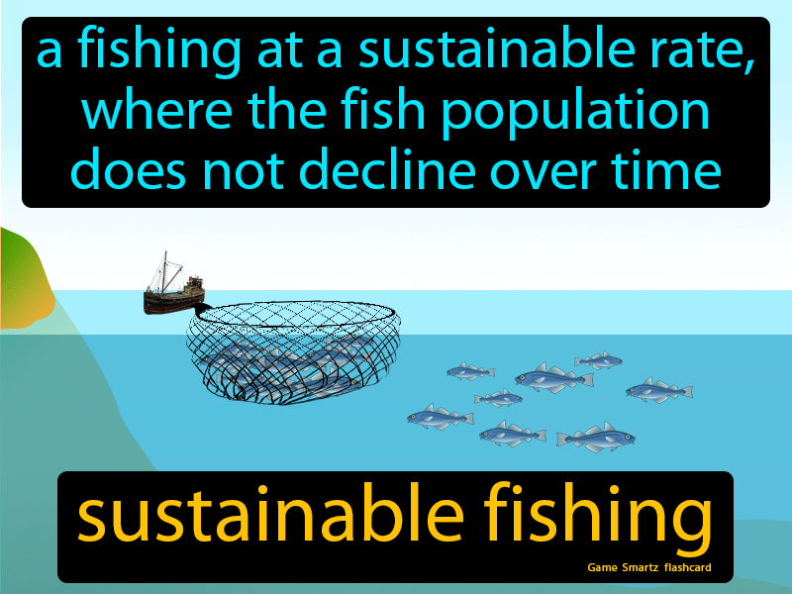
HOW TO BEND THE CURVE CONT’D
Sustainable fisheries
14

Slide 15

HOW TO BEND THE CURVE CONT’D
Education and Awareness
15

Slide 16
CHALLENGES
The Bending the Curve Initiative is associated with the World Wide Fund for Nature (WWF),the world’s leading conservation organisation.
They face some challenges in effort to bend the curve of biodiversity decline;
Scale and scope of ecosystems worldwide
Limited Resources
Institutional and Policy barriers
Poor global cooperation
16

Slide 17

CONCLUSION
Multiple models have been integrated to help us understand how we can reverse the loss of nature, save millions of species from extinction, and guard humans against a risky future thus ‘Bending the curve of biodiversity decline’ requires collective action and cooperation among stakeholders, policy makers, farmers, industries, businesses, Government and NGOs to save biodiversity.
17

Slide 18
REFERENCES
WWF(2022). Almond, R.E.A.;Grooten,
M.;Juffe Bignoli, D. Peterson, Living Planet Report 2022- Building a nature-positive society.
Convention on Biological Diversity (CBD)
Gland Switzerland: Living Planet Report by
World Wide Fund for Nature (WWF).
18

Slide 19

19

